Slide 1




University Institute of Engineering
Department of Computer Science & Engineering
COMPUTER ORGANIZATION & ARCHITECTURE
(23CST-204/23ITT-204)
ER. SHIKHA ATWAL
E11186
ASSISTANT PROFESSOR
BE-CSE

Slide 2
BASIC TERMINOLOGIES
Instruction: Order given to a computer processor by a computer program to compute any task.
Program: Sequence of machine instructions is called a program.
Language: System of communication that is used is called a language.
Programming Language: Set of rules that a programmer use to develop software or to write some instructions for a computer to understand.

Slide 3
INSTRUCTION SET ARCHITECTURE
The instruction set provides commands to the processor, to tell it what it needs to do. The instruction set consists of addressing modes, instructions, native data types, registers, memory architecture, interrupt, and exception handling, and external I/O.
An instruction set architecture (ISA) is an abstract model of a computer. It is also referred to as architecture or computer architecture. A realization of an ISA is called an implementation. An ISA permits multiple implementations that may vary in performance, physical size, and monetary cost (among other things); because the ISA serves as the interface between software and hardware.

Slide 4
INSTRUCTION SET ARCHITECTURE
Software that has been written for an ISA can run on different implementations of the same ISA. This has enabled binary compatibility between different generations of computers to be easily achieved, and the development of computer families.
Both of these developments have helped to lower the cost of computers and to increase their applicability. For these reasons, the ISA is one of the most important abstractions in computing today.

Slide 5
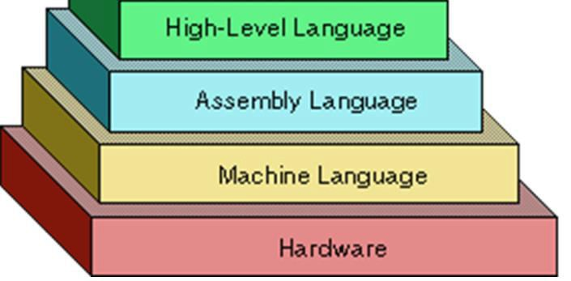
LEVELS OF PROGRAMMING LANGUAGES
The various levels of programming languages are as shown below.
Level of Languages

Slide 6

Machine Language
Language closer to the hardware itself is machine language.
Programs written in machine language are highly efficient.
It is in form of binary code (0 and 1) and that makes it difficult to memorize different binary codes.
Example of Machine Language LIGHT BULB
00000000: STOP PROGRAM
00000001: TURN BULB ON
00000010: TURN BULB OFF
00000100: DIM BULB BY 10%
00001000: BRIGHTEN BULB BY 10%
Light bulb Programming

Slide 7
Assembly Language
An assembly (or assembler) language, often abbreviated ASM, is a low-level programming language for a computer, or other programmable device, in which there is a very strong (but often not one-to-one) correspondence between the language and the architecture's machine code instructions. Each assembly language is specific to a particular computer architecture. In contrast, most high-level programming languages are generally portable across multiple architectures but require interpreting or compiling. Assembly language may also be called symbolic machine code.
Assembly language is converted into executable machine code by a utility program referred to as an assembler. The conversion process is referred to as assembly, or assembling the source code. Assembly time is the computational step where an assembler is run.

Slide 8
Rules of ASM Language
Each line of an assembly language program is arranged in three columns called fields. The fields specify the following information.
The label field may be empty or it may specify a symbolic address.
The instruction field specifies a machine instruction or a pseudo instruction.
The comment field may be empty or it may include a comment.
A symbolic address consists of one, two, or three, but not more than three alphanumeric characters.
The first character must be a letter; the next two may be letters or numerals. The symbol can be chosen arbitrarily by the programmer. A symbolic address in the label field is terminated by a comma so that it will be recognized as a label by the assembler.

Slide 9
3. High Level Language
High-level language is a programming language designed to simplify computer programming. It is "high-level" since it is several steps removed from the actual code run on a computer's processor.
High-level source code contains easy-to-read syntax that is later converted into a low- level language, which can be recognized and run by a specific CPU.
High-level language" refers to the higher level of abstraction from machine language. Rather than dealing with registers, memory addresses and call stacks, high-level languages deal with variables, arrays, objects, complex arithmetic or boolean expressions, subroutines and functions, loops, threads, locks, and other abstract computer science concepts, with a focus on usability over optimal program efficiency.

Slide 10
Unlike low-level assembly languages, high-level languages have few, if any, language elements that translate directly into a machine's native opcodes. Other features, such as string handling routines, object-oriented language features, and file input/output, may also be present.
LANGUAGE PROCESSORS/TRANSLATORS
A translator takes a program written in source language as input and converts it into a program in target language as output.
Types of Processors/Translators
Compilers
Interpreters
Assemblers

Slide 11
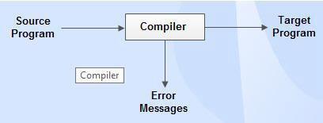
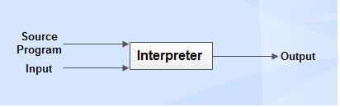
Compilers: Compiler is a translator which is used to convert programs in high-level language to low-level language.
Use of Compiler
Interpreters: Interpreter is a translator which is used to convert programs in high-level language to low-level language.
Use of Interpreter

Slide 12

Assemblers: Assembler is a translator which is used to translate the assembly language code into machine language code.
Use of Assembler

Slide 13
References
Reference Books:
J.P. Hayes, “Computer Architecture and Organization”, Third Edition.
Mano, M., “Computer System Architecture”, Third Edition, Prentice Hall.
Stallings, W., “Computer Organization and Architecture”, Eighth Edition, Pearson Education.
Text Books:
Carpinelli J.D,” Computer systems organization &Architecture”, Fourth Edition, Addison Wesley.
Patterson and Hennessy, “Computer Architecture”, Fifth Edition Morgaon Kauffman.

Slide 14
Reference Website
https://thebittheories.com/levels-of-programming-languages-b6a38a68c0f2
https://www.cs.toronto.edu/~gpenn/csc324/lecture2.pdf
https://www.britannica.com/technology/computer-programming-language
Video References
https://www.youtube.com/watch?v=RHvioCFOzZo
https://www.youtube.com/watch?v=BQleAPh1Z3I

